Slide 1






Evolution of Blockchain
Industry Use
Code
Currency
Blockchain 3.0
- Industry Blockchain
Blockchain 2.0
- Smart contracts
Blockchain 1.0
- Simple ledgers that
record transactions

Slide 2
Blockchain 2.0 Ethereum Smart Contract
Notes:
Check metamask. Make sure you have 1 ETH

Slide 3
Preparation

Slide 4
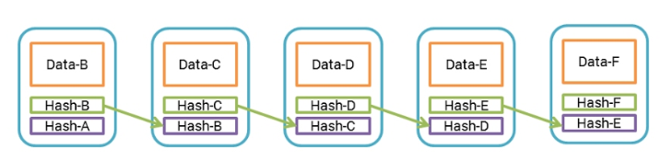
Blockchain
Notes:
Did you guys remember that in previous Blockchain introduction, blocks are used to stored data.
And the data that are stored is different between every blockchain system.
Bitcoin stored transaction ( for example A transfer 1 BTC to B)

Slide 5

Smart Contract
Code
Notes:
In Ethereum Blockchain, we have the ability to store a program/code into the data section of the Blockchain.
These piece of program that are stored in the block are called Smart Contract.

Slide 6
Ethereum Virtual Machine
- Programmable Blockchain
- Create own operations and complexity
- Serve as a platform for decentralized Blockchain applications.
Notes:
Ethereum is a programmable blockchain. Rather than give users a set of pre-defined operation (for example, bitcoin transactions), Ethereum allows users to create their own
Operations of any complexity they wish. In this way, it serves as a platform for many different types of decentralized blockchain applications, including but not limited to crypto-currencies.

Slide 7
Characteristics
- Distributed
- Immutable
- History
Notes:
Basically a smart contract will have the same characteristic as Blockchain because it is deployed into a Blockchain network.
Which means a smart contract will be distributed (Everyone in the network can use this program)
A smart contract is immutable (Once is it deployed, the code no longer can be updated or deleted)
A smart contract has history (Like who has called this function, update the data inside the contract)

Slide 8

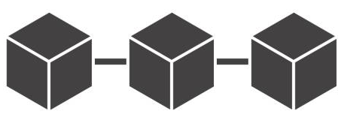






Notes:
In Ethereum network, once the piece of program had been deployed, every one in the network will have the program.
Which means everyone in the network can execute this piece of code.

Slide 9
Smart Contract Terminology
- Contract Address
- Contract ABI
Notes:
Contract address – The address where the piece of code will be located. You will need this address to execute the functions in the program.
You can think it as your home address, to find you at home, you will need Waze/google map there.
Contract ABI – This is the interface(function declaration) of the piece of code which is needed for application to execute functions in the program.
Let say you have develop an application and have a function called showMeTheMoney(int howmuch), you will need an interface to tell other people,
hey I have a function named showMeTheMoney and you will need to pass me an integer of how much. Right?

